Slide 1

Airline Analysis
Project Web URL: http://airlineanalysis.epizy.com/?i=1
Hetal Patel
885868455
Lency Lakhani
885196055
Prof. Tseng-Ching Shen
CPSC 531- Adv Database Management

Slide 2
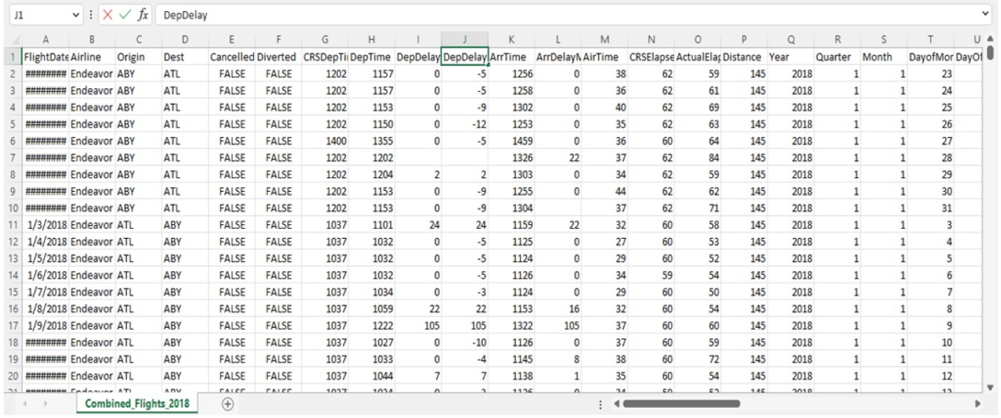
Airline Analysis Dataset
Airline analysis dataset from kaggel website
Dataset Size: 1.9 GB

Slide 3
Airline Analysis Project Description
Used Elastic MapReduce (EMR) to scale and run big data servers on the cloud
AWS EMR is pre-installed and pre-configured with Spark and Hadoop
Used AWS EC2 instances as worker nodes- 1 Master and 2 Core nodes
Used AWS S3 bucket as file system for storing files
Used Python PySpark SQL libraries to perform Spark job to store and process data
Performed analysis on airline dataset on EMR cluster to execute query to fetched the analyzed data

Slide 4
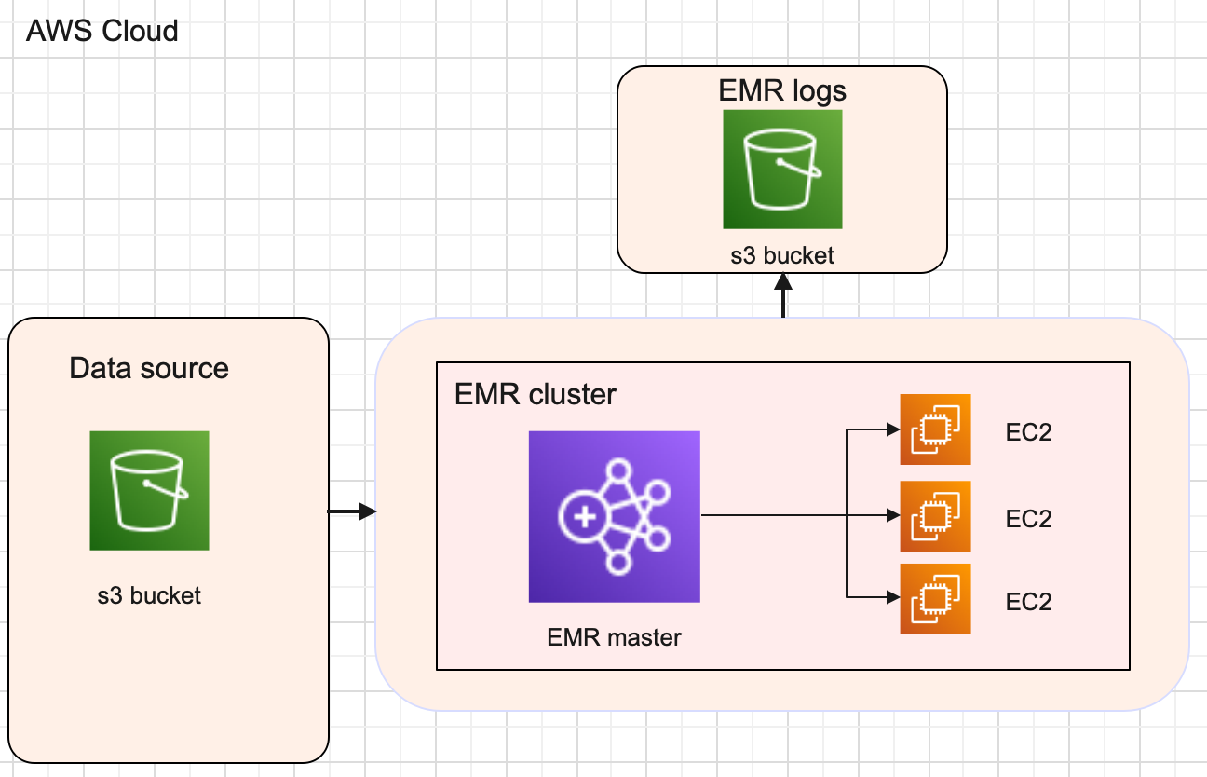
Overview of Design

Slide 5
Overview of Implementation
Login to AWS console and create S3 bucket, then upload source file(csv file) for EMR cluster to access it
Spark code in python for spark storage job to process data
Create EMR cluster and select the instances (3 : 1 master and 2 core nodes)
After the EMR job is completed, the required output files are generated in given s3 bucket output folder
Download and view the output files
Terminate the EMR cluster

Slide 6
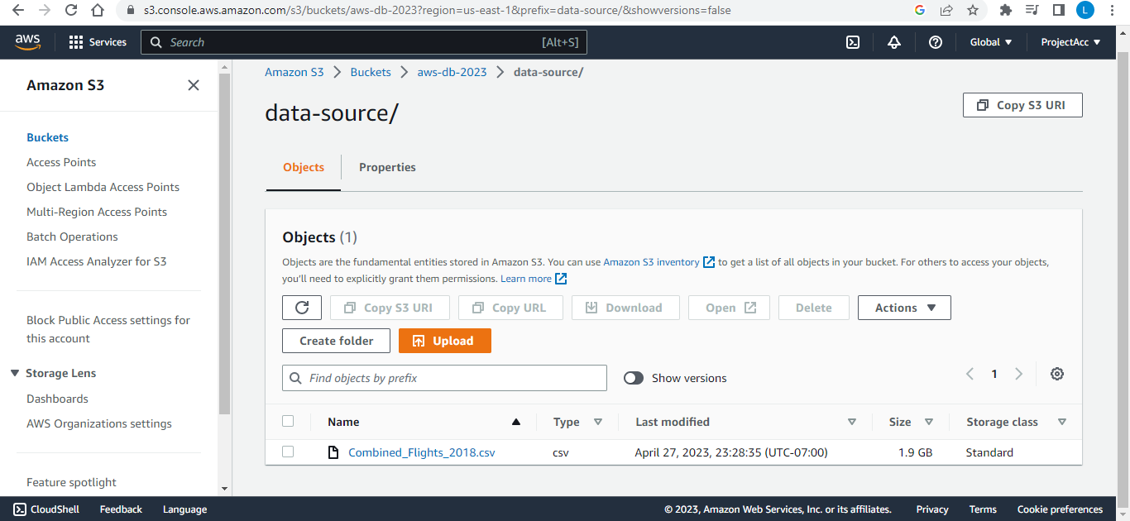
Login to AWS console and create S3 bucket, then upload source file(csv file) for EMR cluster to access it

Slide 7
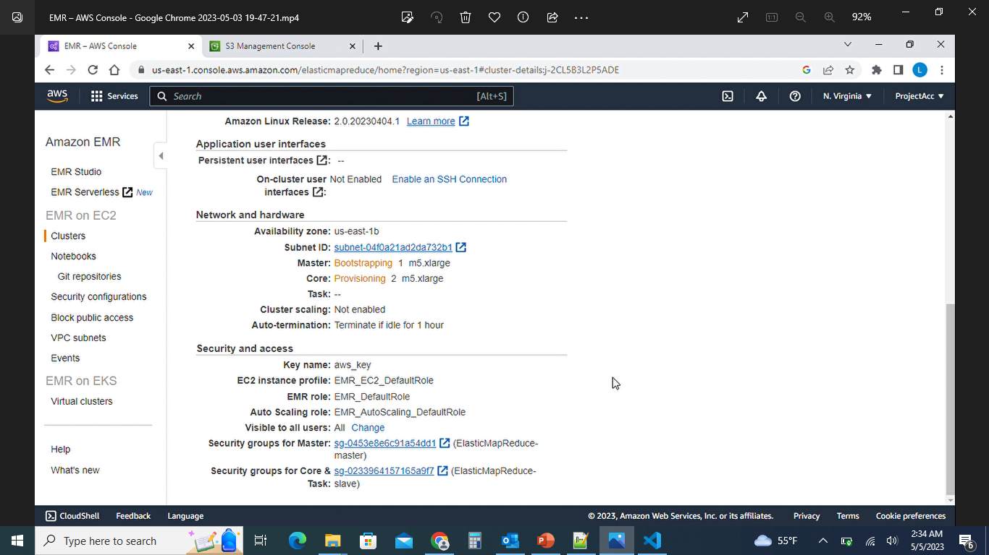
Create EMR cluster and select the instances (3 : 1 master and 2 core nodes)

Slide 8
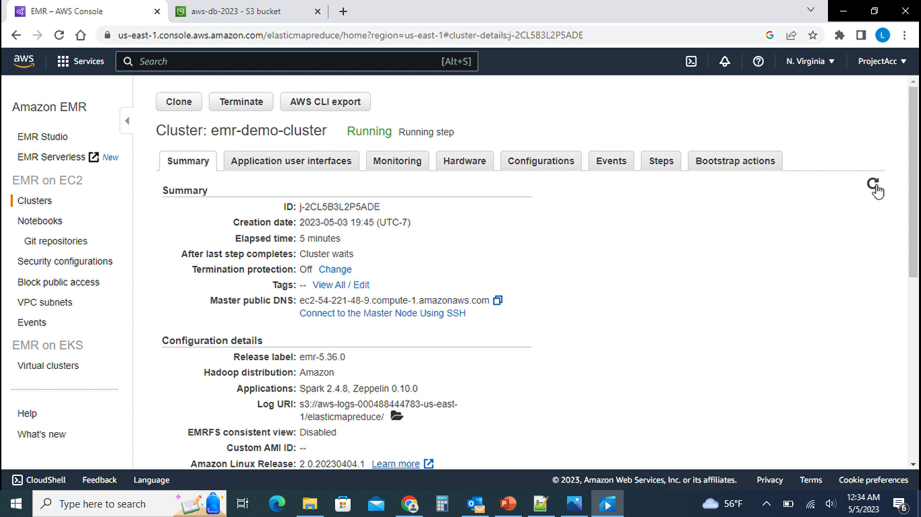
Running EMR cluster to process the output

Slide 9
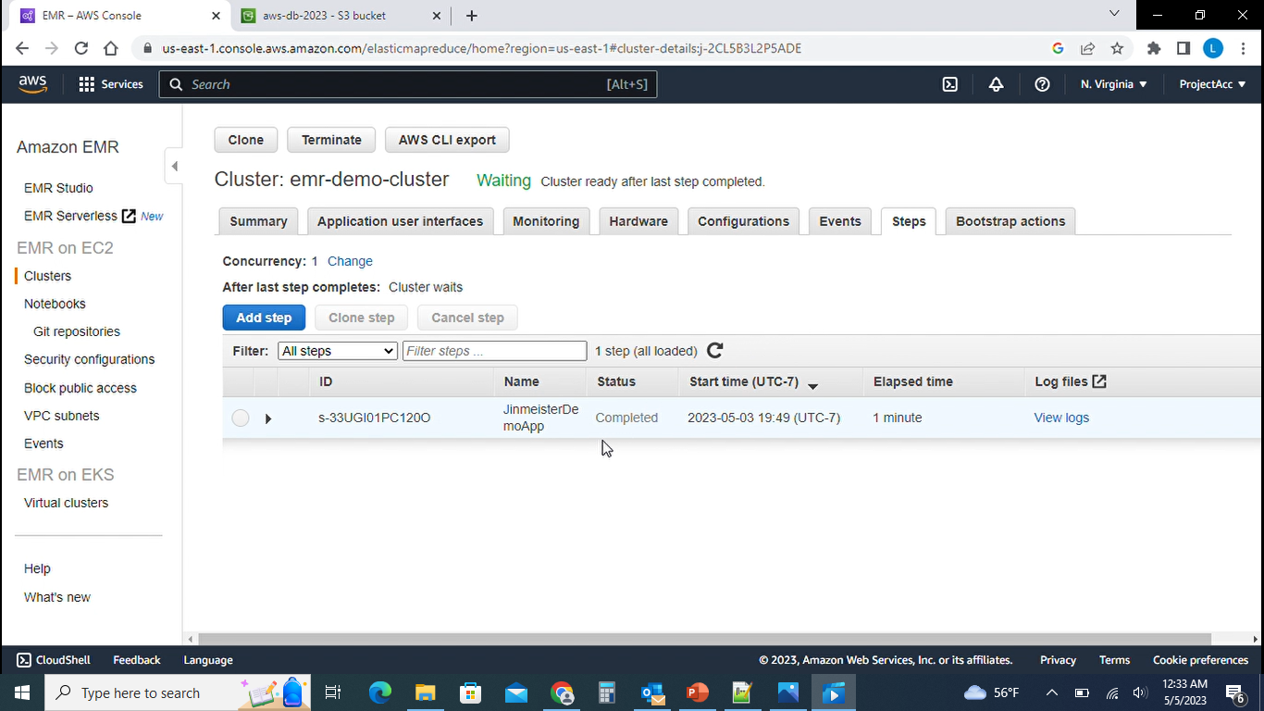
Completed EMR Cluster

Slide 10
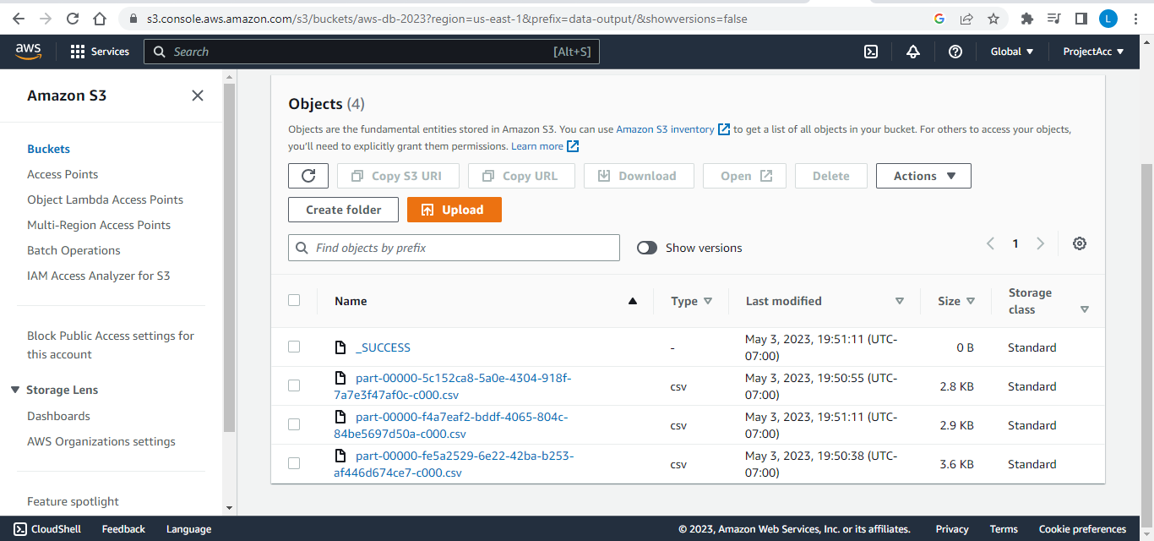
Output files generated in given s3 bucket output folder

Slide 11
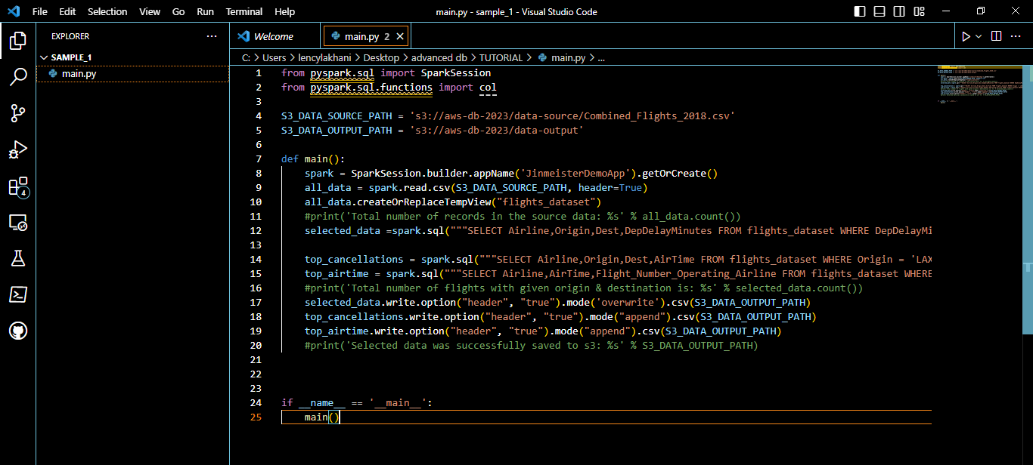
Spark code in python for spark storage job to process data

Slide 12
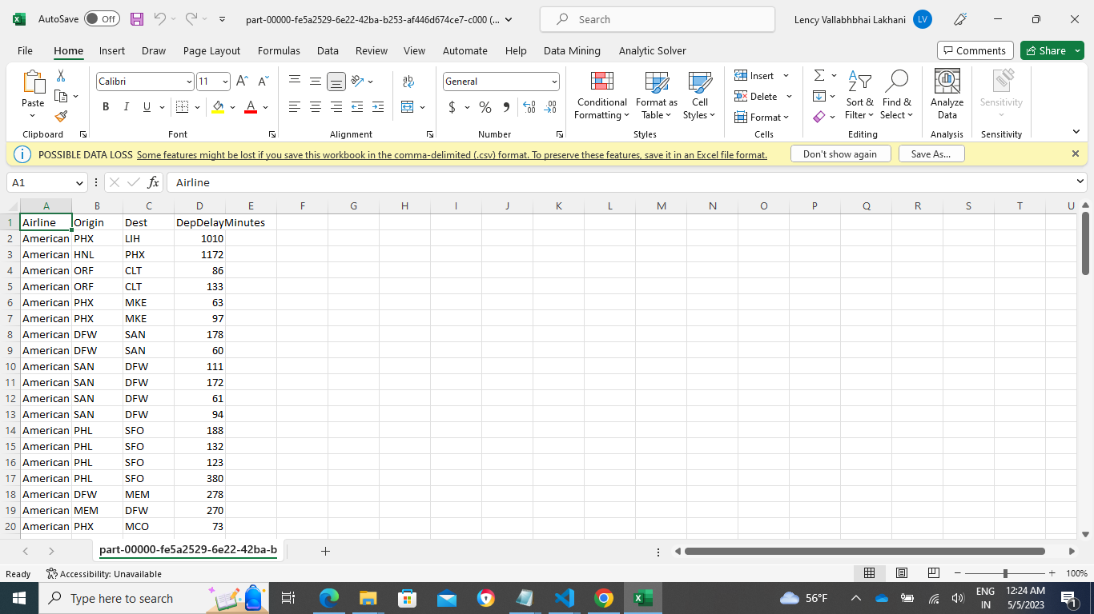
Download and view the output files – Delay Analysis Output File
SELECT Airline,Origin,Dest,DepDelayMinutes FROM flights_dataset WHERE DepDelayMinutes >= 60 AND Airline = 'American Airlines Inc.' LIMIT 100

Slide 13
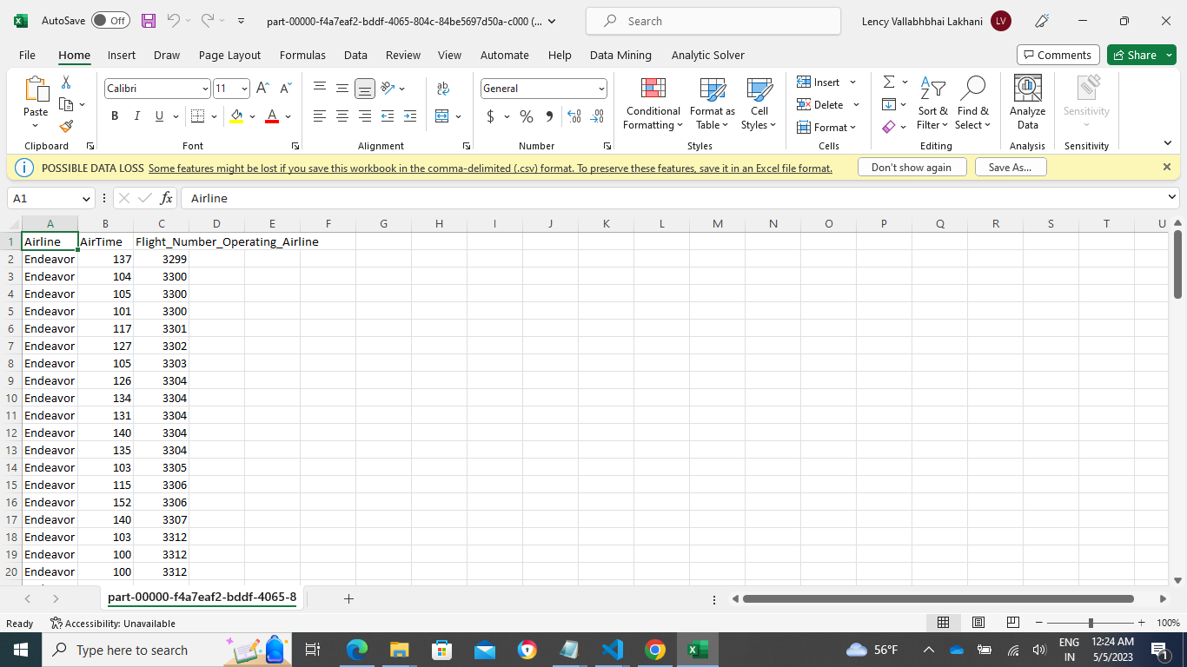
Download and view the output files – Airtime Analysis Output File
SELECT Airline,AirTime,Flight_Number_Operating_Airline FROM flights_dataset WHERE AirTime >=100 LIMIT 100

Slide 14
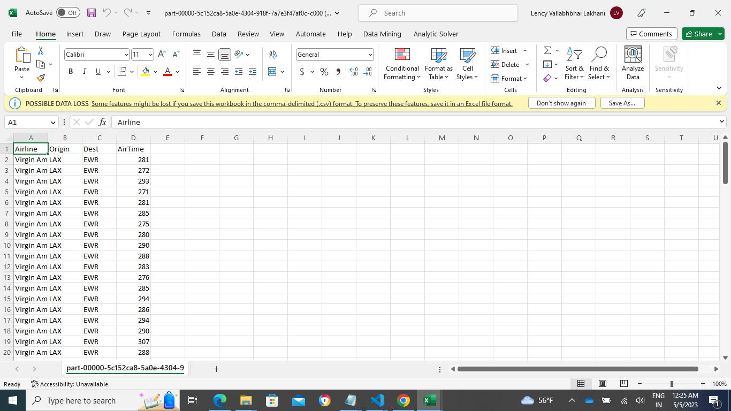
Download and view the output files – Destination Analysis Output File
SELECT Airline,Origin,Dest,AirTime FROM flights_dataset WHERE Origin = 'LAX' AND Dest = 'EWR' ORDER BY Airline DESC LIMIT 100

Slide 15
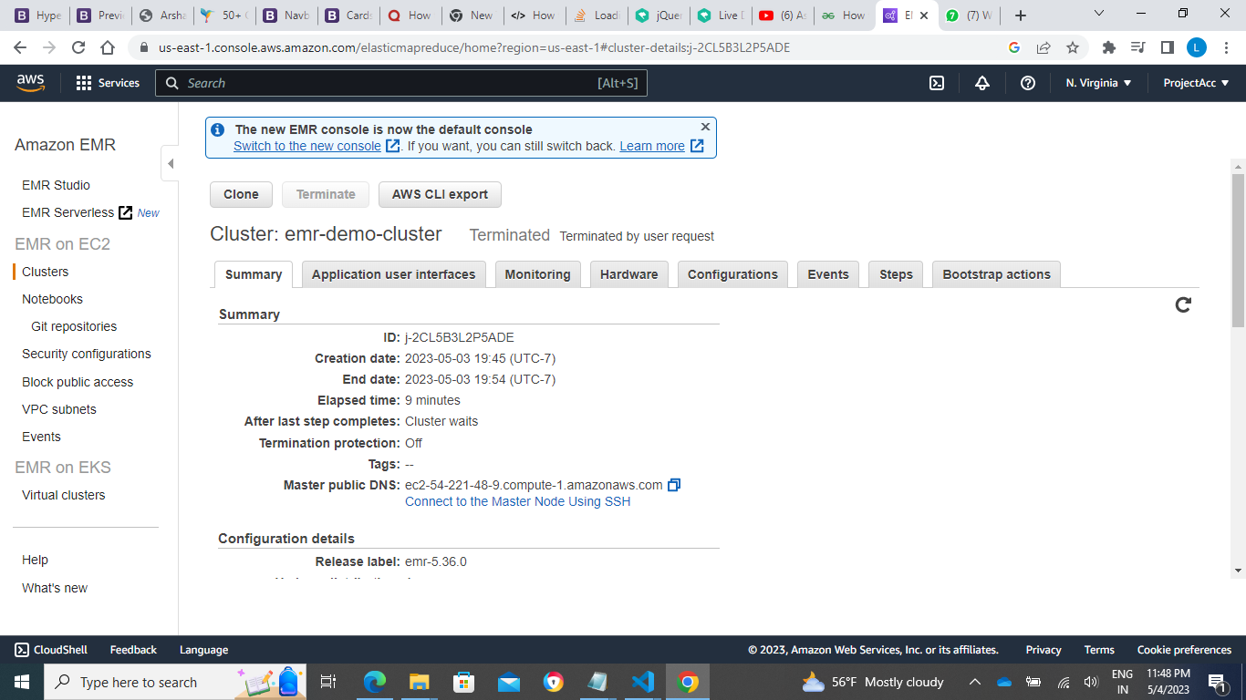
Terminate the EMR cluster

Slide 16
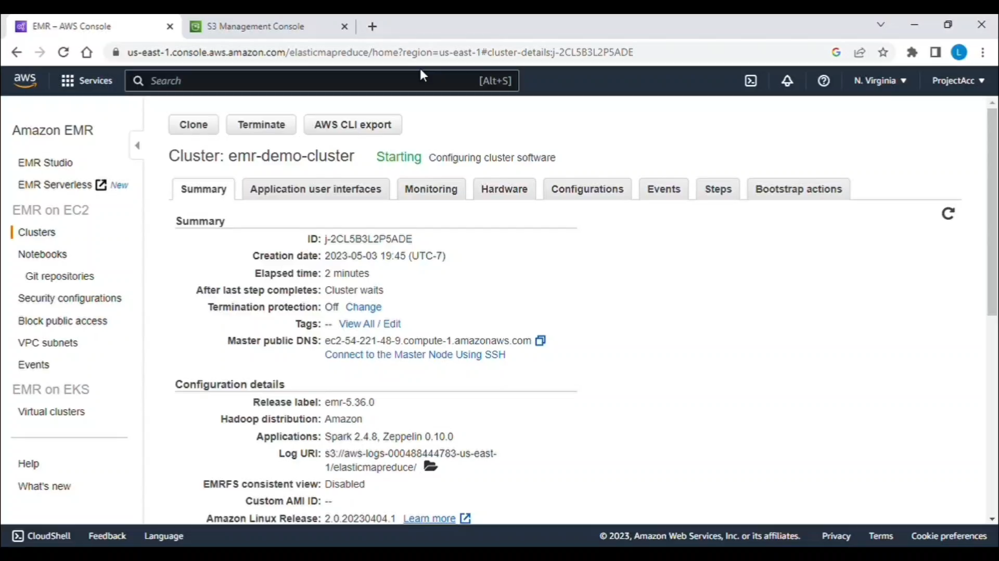
Demo Video

